Slide 1

Econometric Property Investment Calculator
Troy Bailey, Seth Bitney, Kat Pin, Valerie Wilmot, & Yuta Yamaguchi

Slide 2







Data Sources
Zillow
City of
Austin
School Digger
US Census Bureau
Texas School Guide
OpenStreetMap

Slide 3
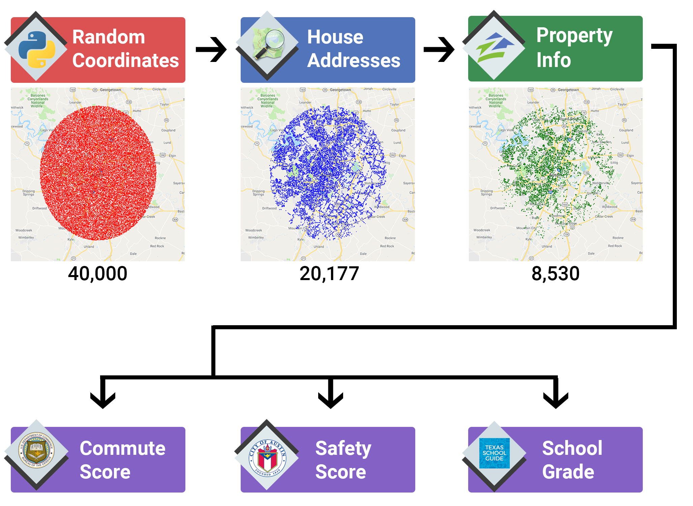
Data Exploration
& Cleanup
Notes:
- Defined city center as Texas State Capital building
- Set radius of 20 miles
Generated 40,000 random geocoordinates
modules used:
random
Math
output to: randomLatLon.csv
- Used randomLatLon.csv
- Queried GeoPy Nominatim API for residential addresses
Cleaned data for further analysis
modules used:
geopy
Time
output to:
addressList.csv
- Used addressList.csv
- Queried Zillow API using PyZillow module for valuation and sqft
- Cleaned data for further analysis
modules used:
pyzillow
GetDeepSearchResults
output to:
masterData.csv

Slide 4
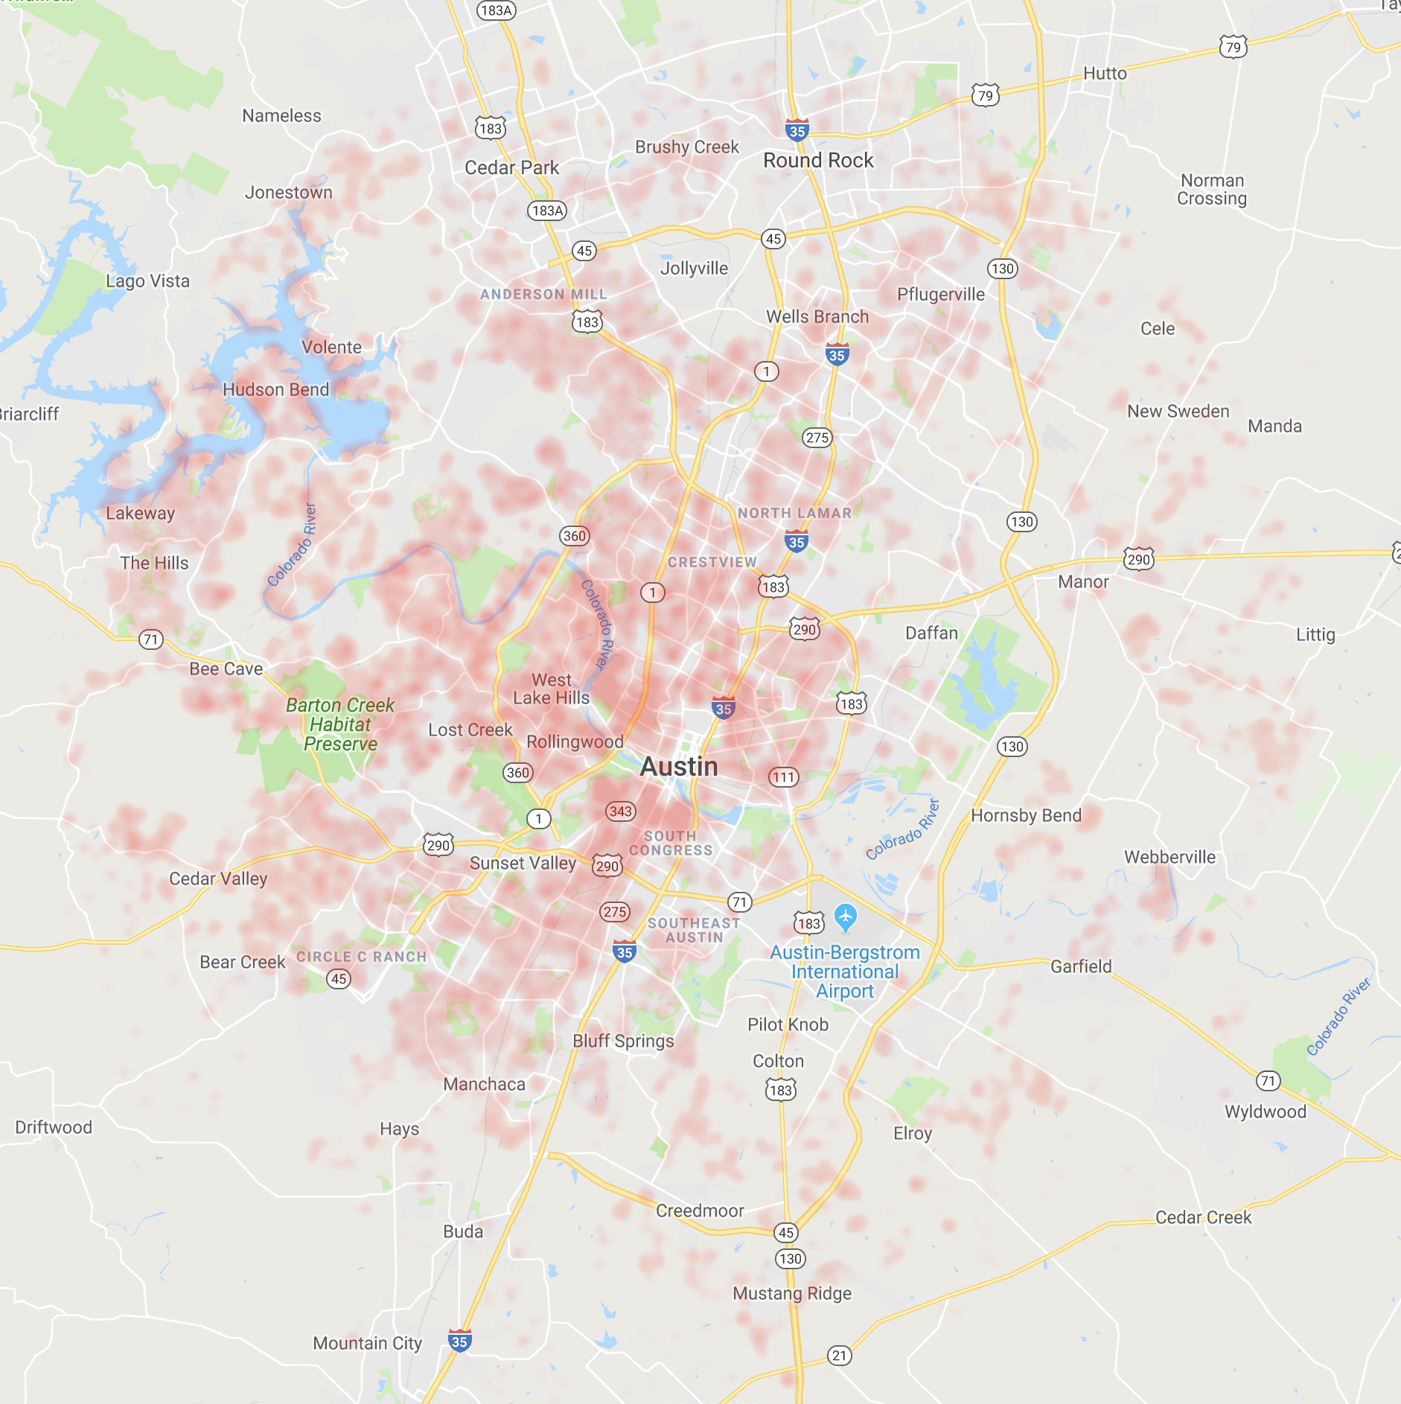
Property Value
Cheap
Expensive

Slide 5
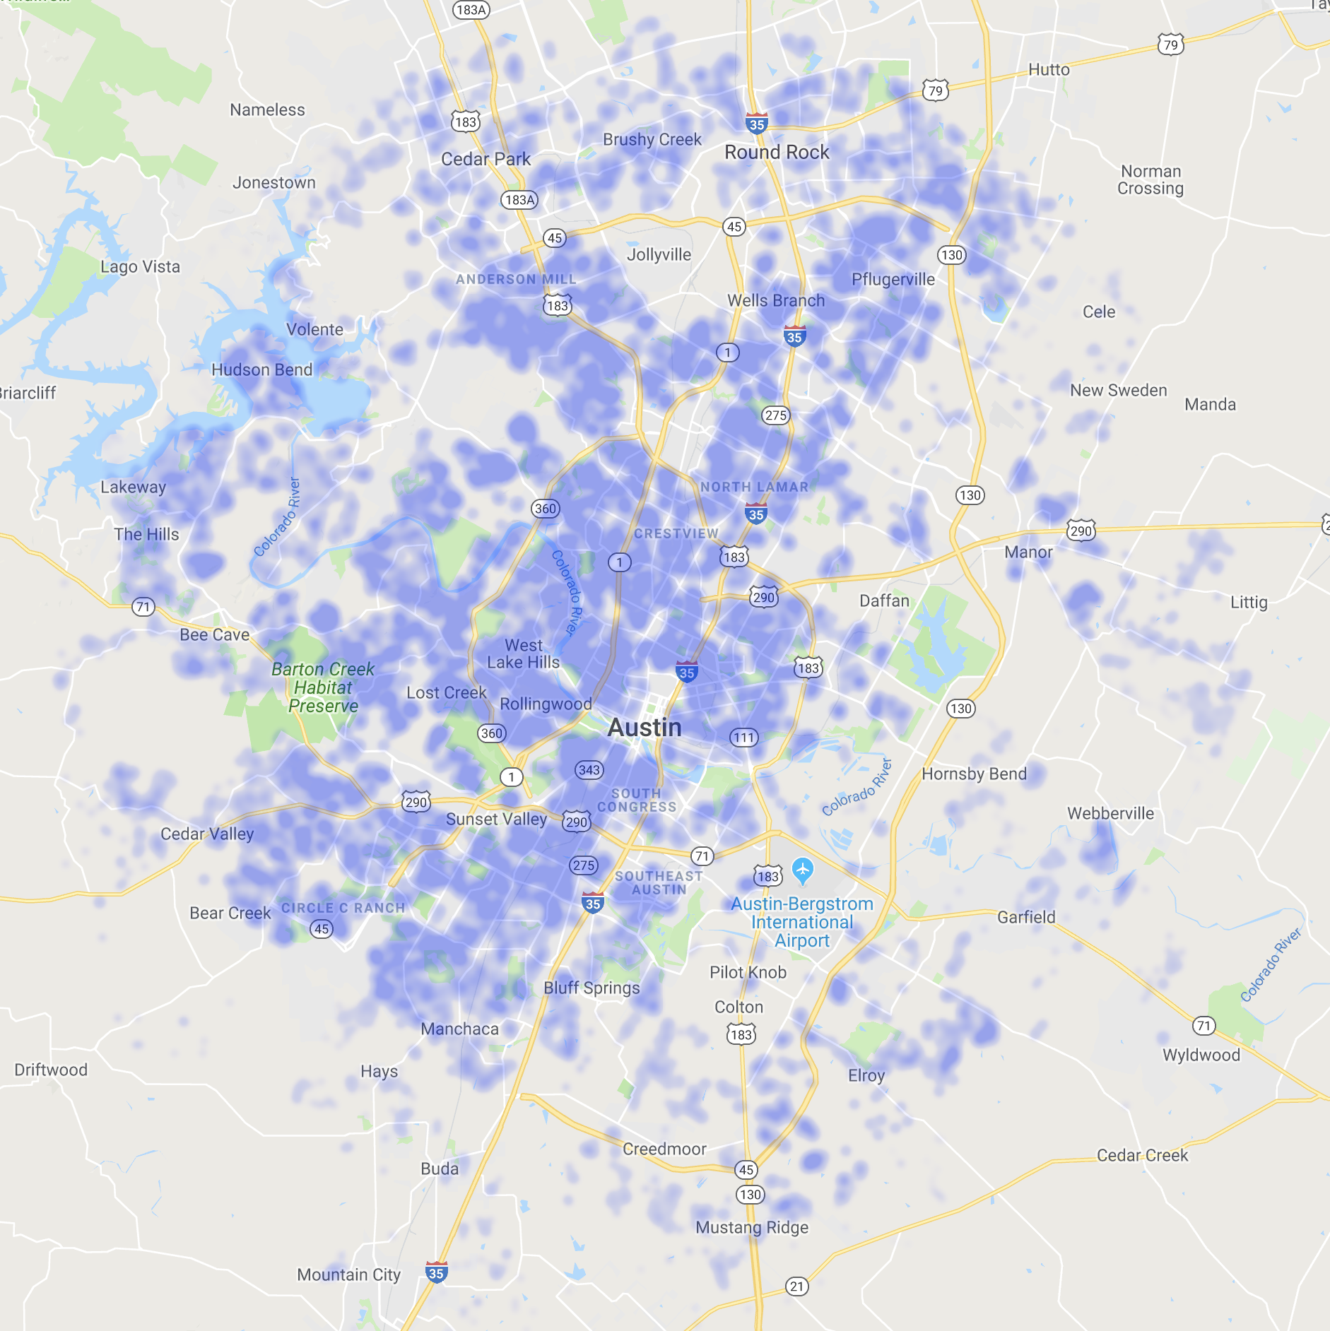
Commute Score
Long
Short

Slide 6
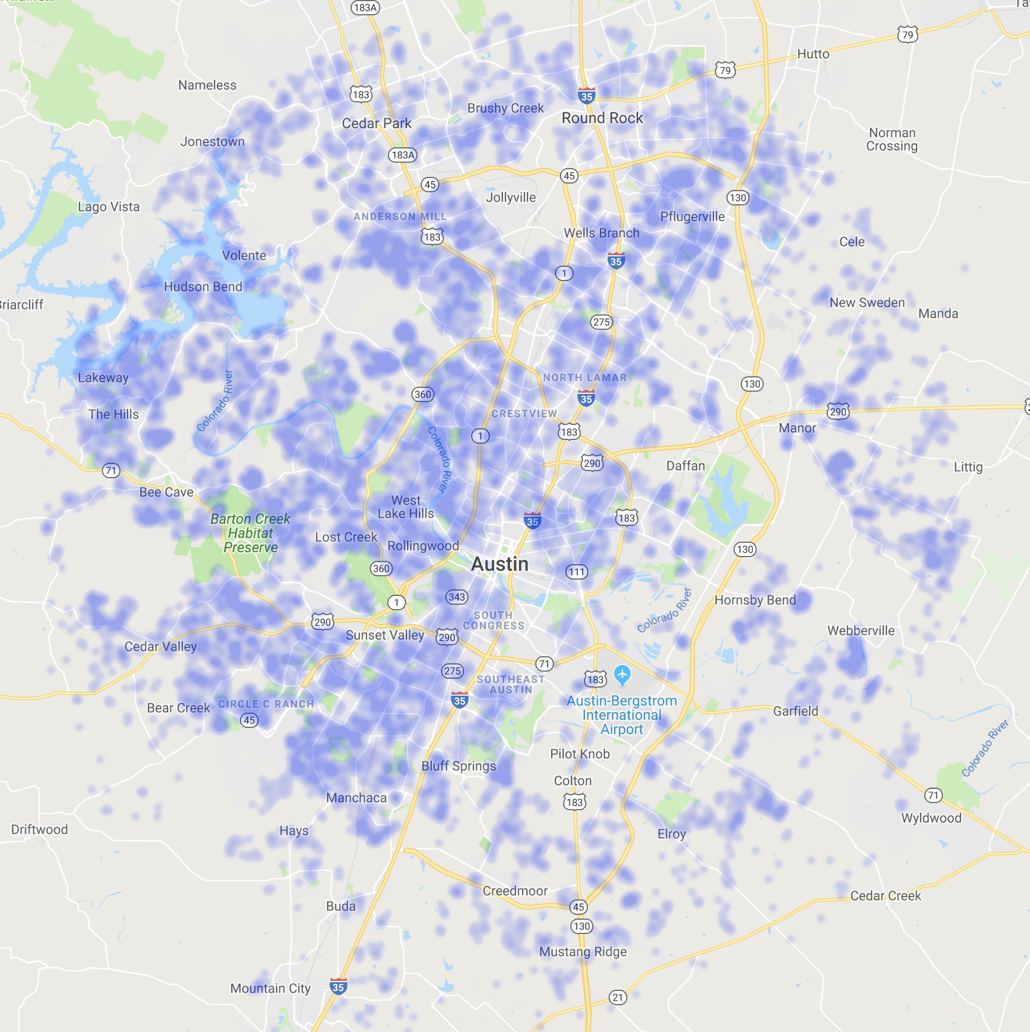
Safety Score
Unsafe
Safe

Slide 7
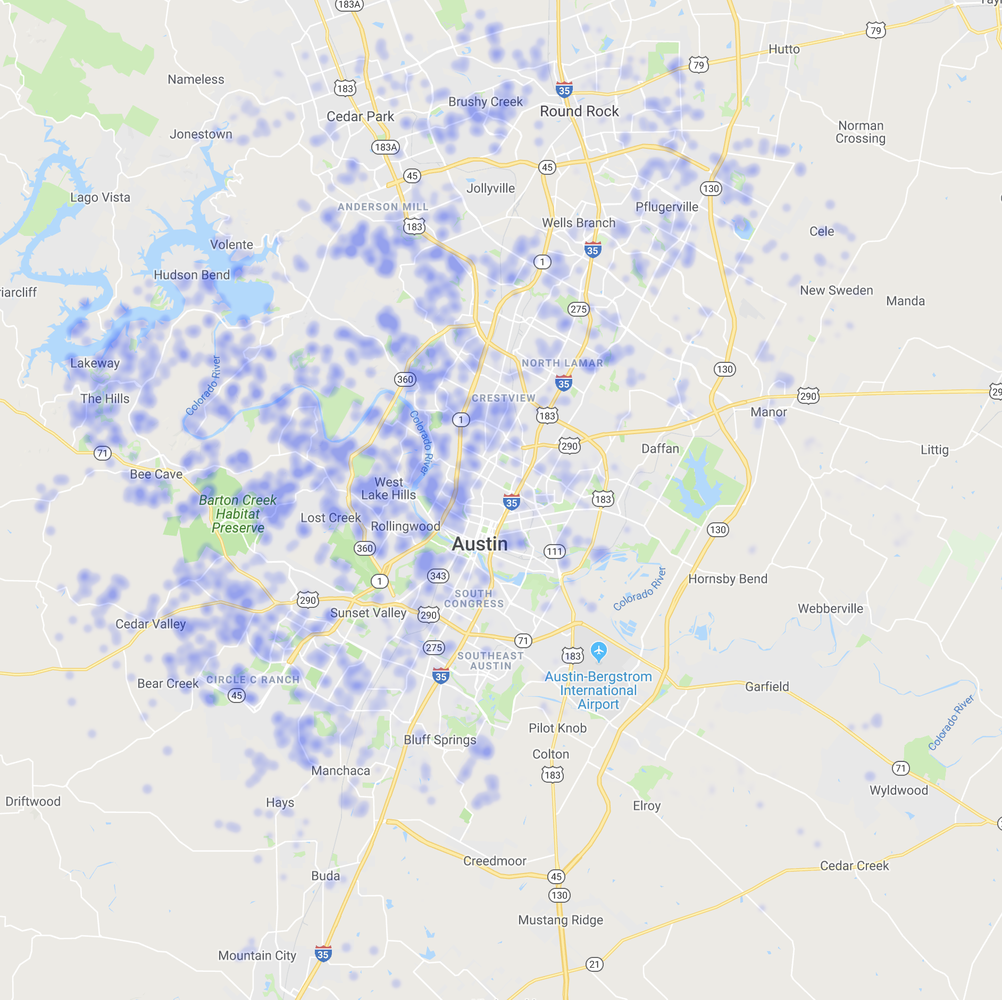
School Grade
Low
High

Slide 8

Analysis

Slide 9
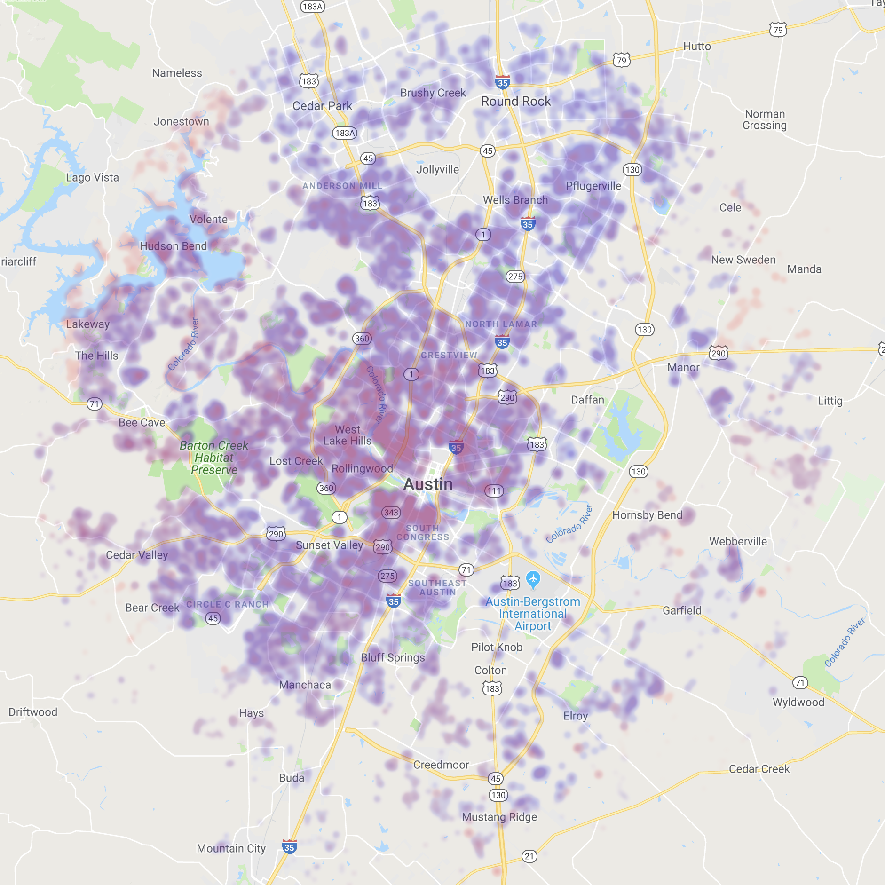
Commute vs Property Value
High property values and low commute times align with locations of big companies
low
high
low
Value
Commute

Slide 10
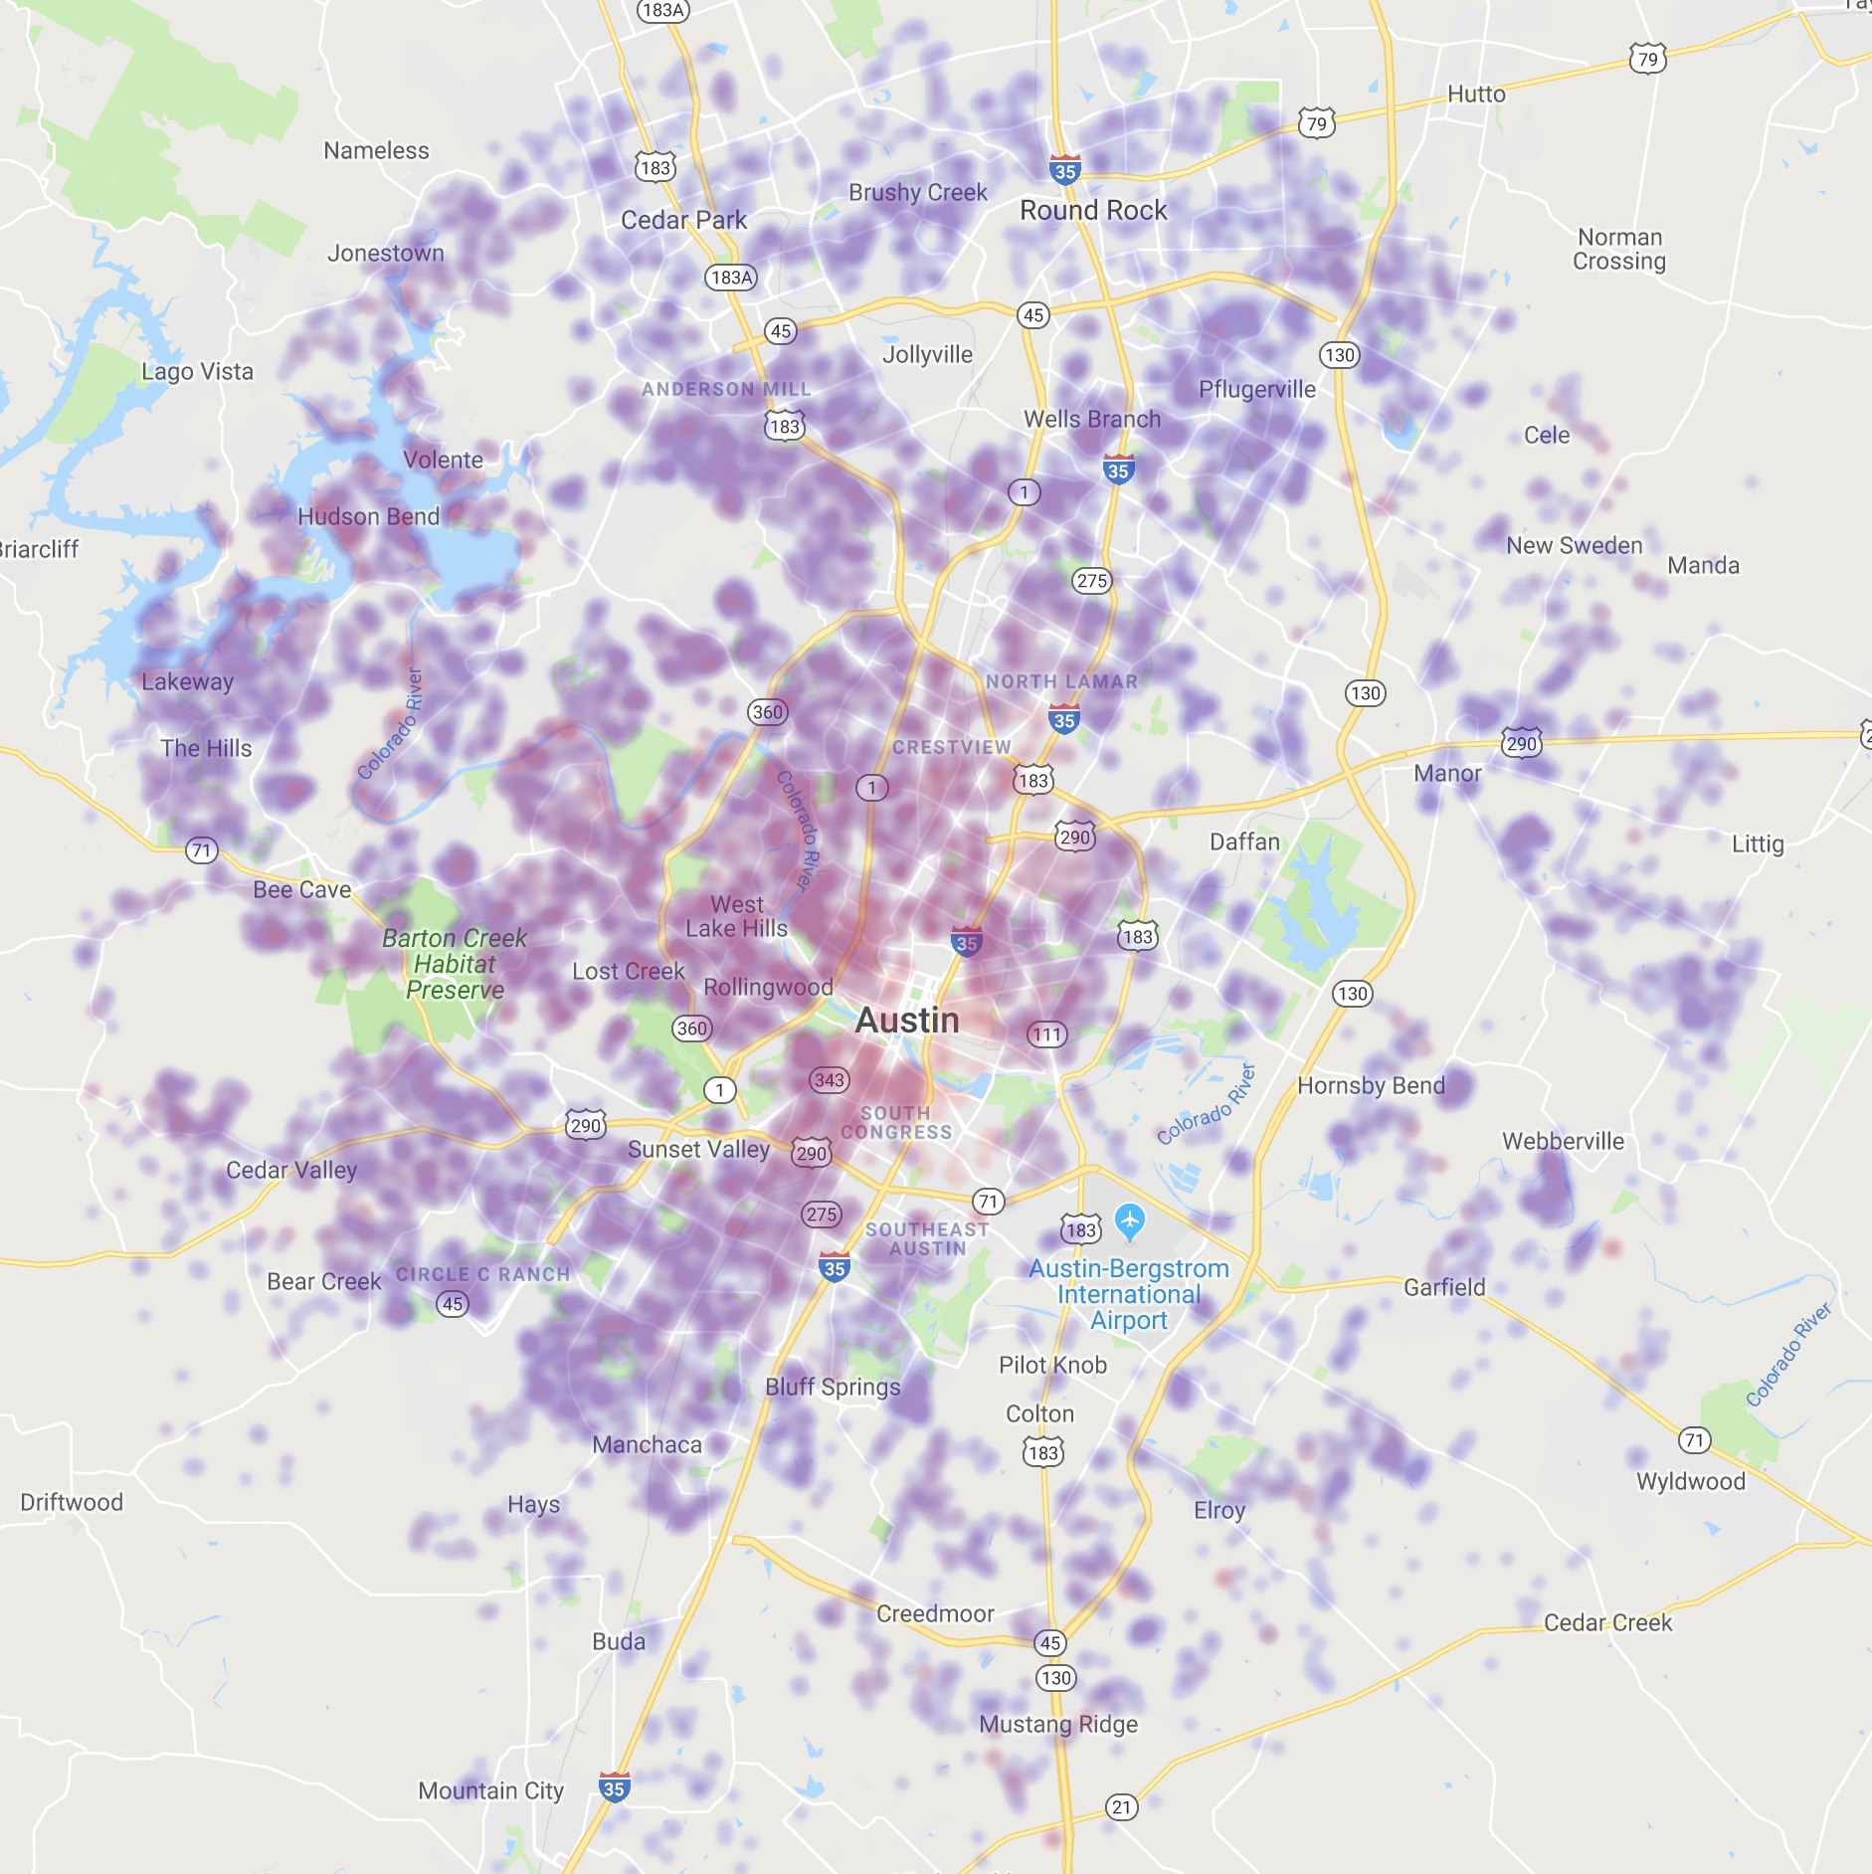
Safety vs Property Value
With the exception of downtown, high property values correlate positively with high safety scores
low
high
low
Value
Safety

Slide 11
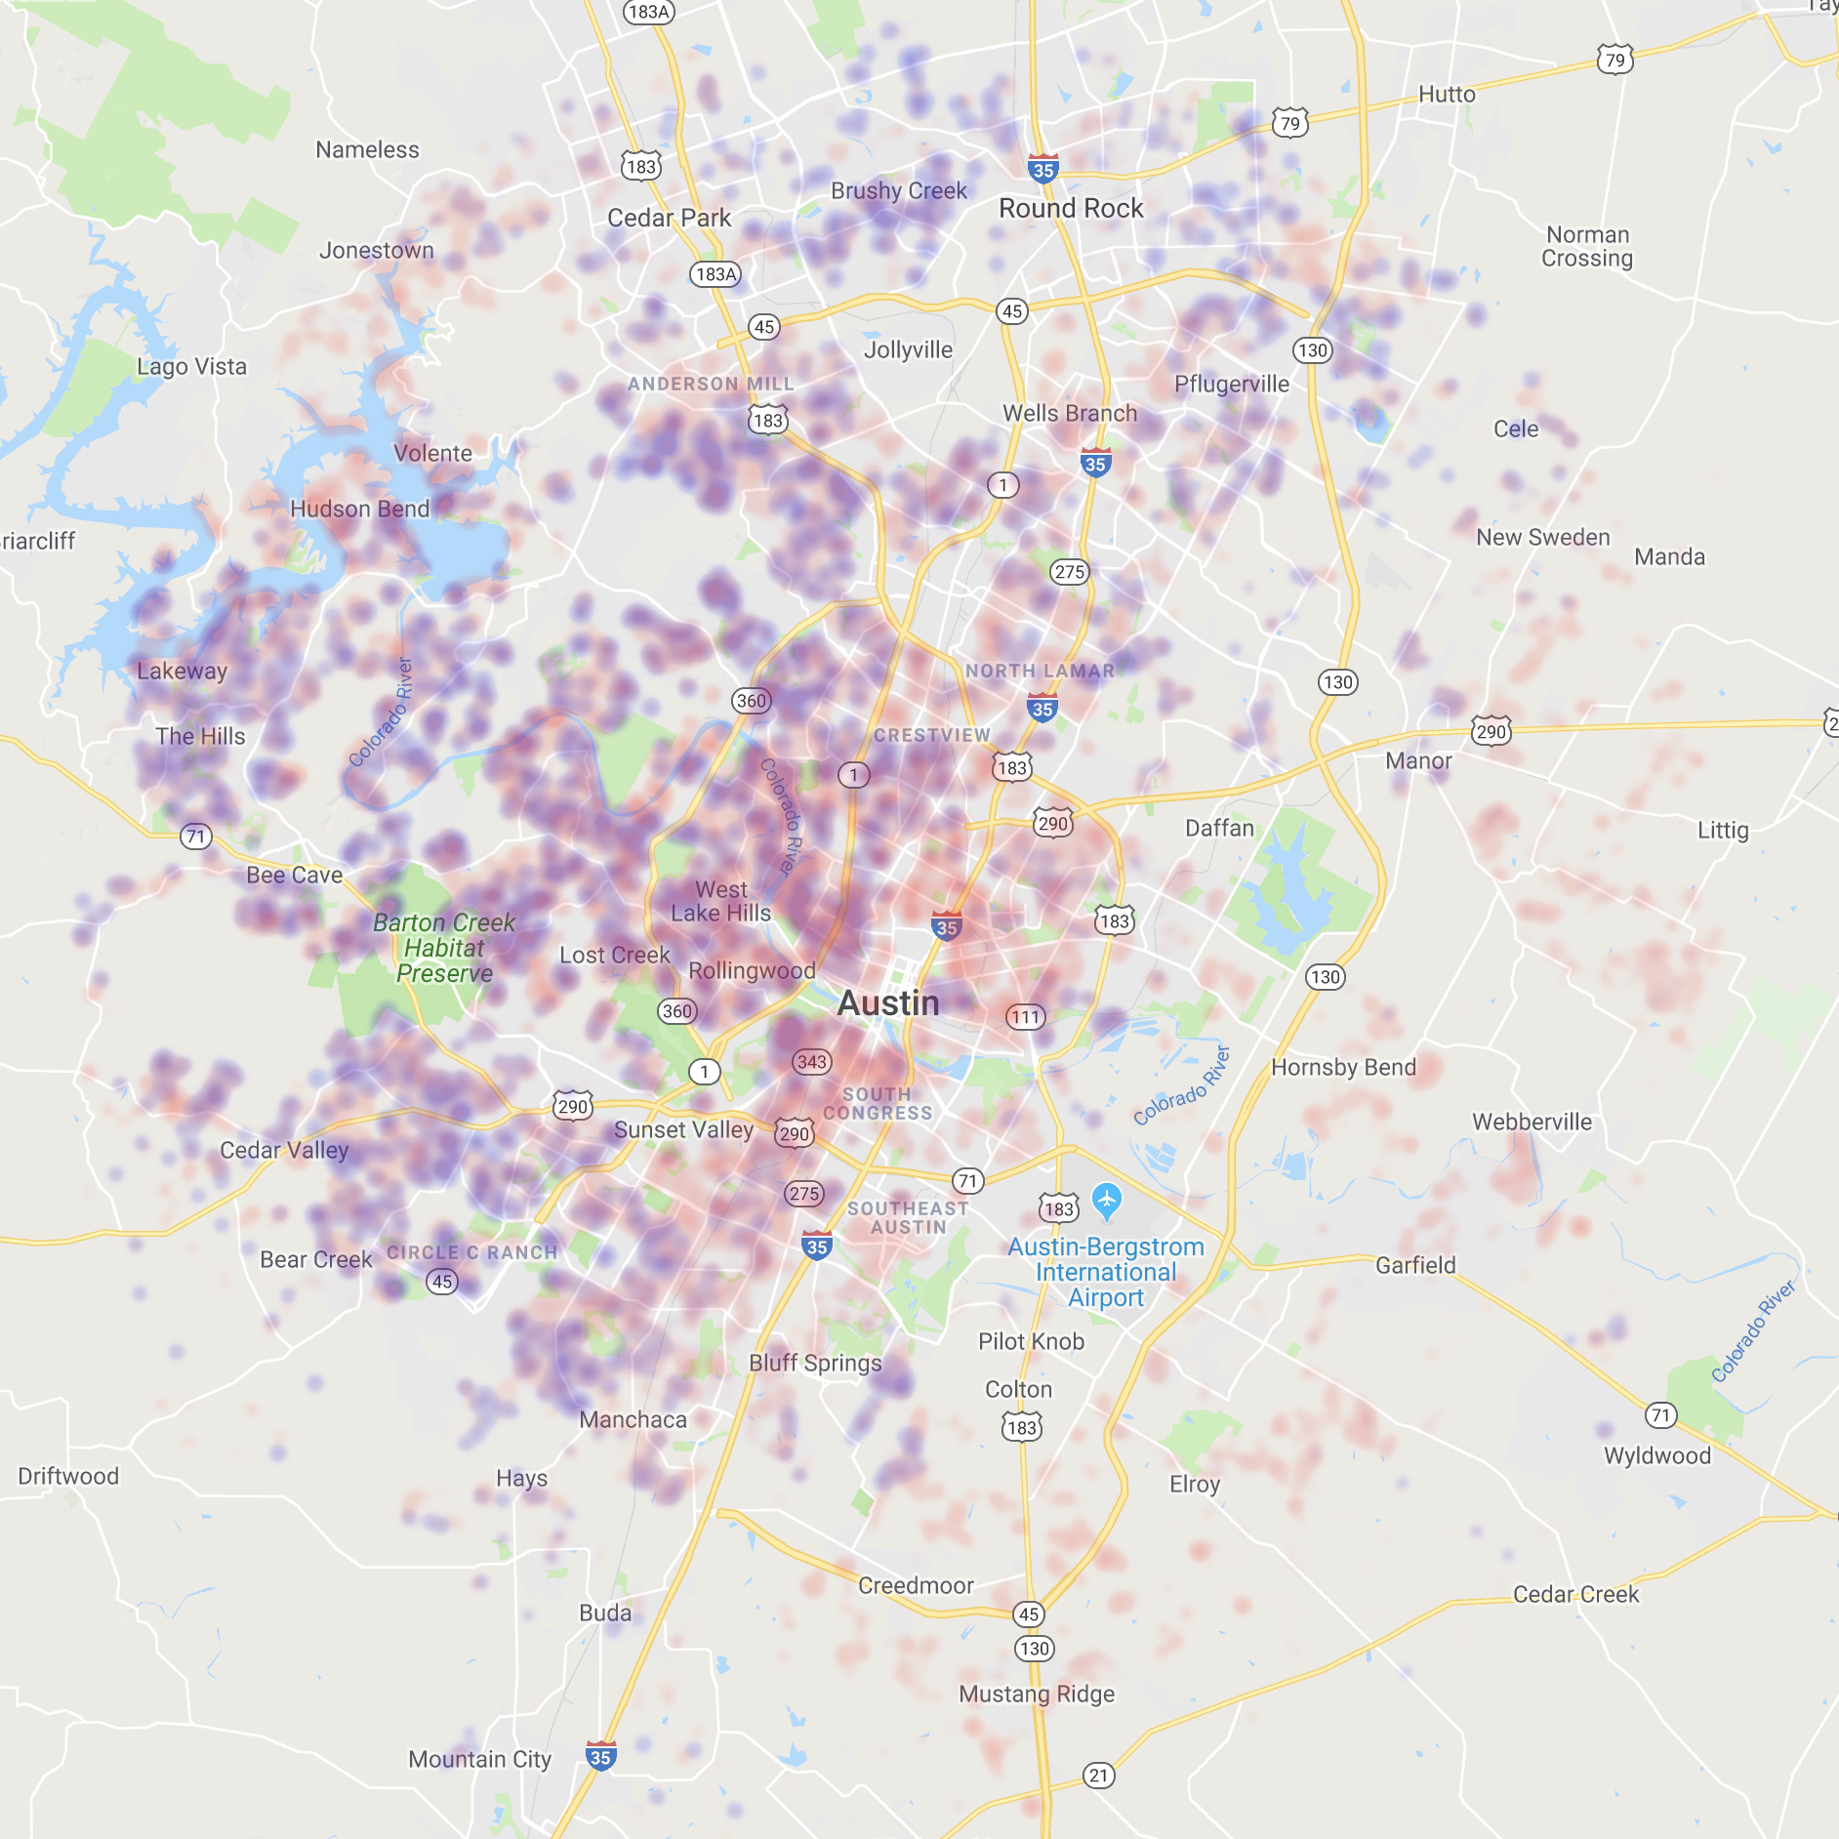
School vs Property Value
Property values and school ratings do not have a strong relationship based on the data used
low
high
low
Value
School

Slide 12

Statistical
Analysis
With statsmodels library, performed multivariable regression analysis using Ordinary Least Squares (OLS) method
valueScore =
constant: 85.792477
+
commuteScore x -0.076133
safetyScore x 0.096824
schoolScore x -0.045400
Notes:
- Defined city center as Texas State Capital building
- Set radius of 20 miles
Generated 40,000 random geocoordinates
modules used:
random
Math
output to: randomLatLon.csv
- Used randomLatLon.csv
- Queried GeoPy Nominatim API for residential addresses
Cleaned data for further analysis
modules used:
geopy
Time
output to:
addressList.csv
- Used addressList.csv
- Queried Zillow API using PyZillow module for valuation and sqft
- Cleaned data for further analysis
modules used:
pyzillow
GetDeepSearchResults
output to:
masterData.csv

Slide 13





Really EPIC Team
Troy Bailey
Seth Bitney
Kat Pin
Meet the Team 05
Valerie Wilmot
Yuta Yamaguchi

